Slide 1
File Handling in C

Slide 2
What is a File?
A file is a collection of related data that a computers treats as a single unit.
Computers store files to secondary storage so that the contents of files remain intact when a computer shuts down.
When a computer reads a file, it copies the file from the storage device to memory; when it writes to a file, it transfers data from memory to the storage device.
C uses a structure called FILE (defined in stdio.h) to store the attributes of a file.

Slide 3
Steps in Processing a File
Create the stream via a pointer variable using the FILE structure:
FILE *p;
Open the file, associating the stream name with the file name.
Read or write the data.
Close the file.

Slide 4
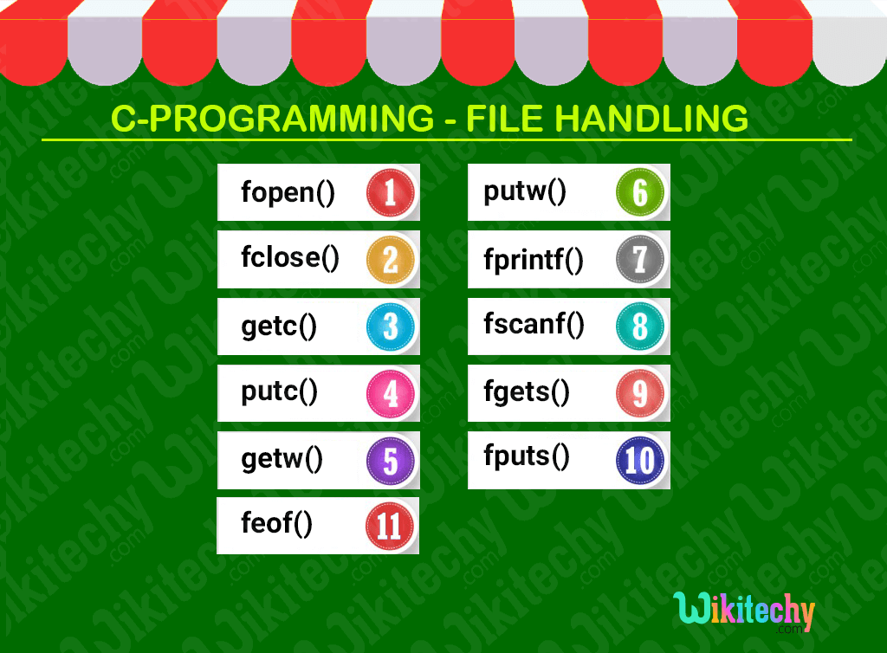

Slide 5
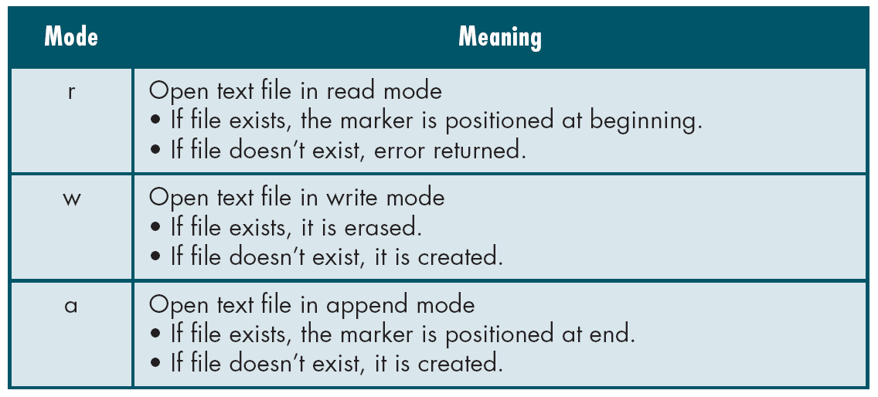
File Open Modes
from Table 7-1 in Forouzan & Gilberg, p. 400

Slide 6
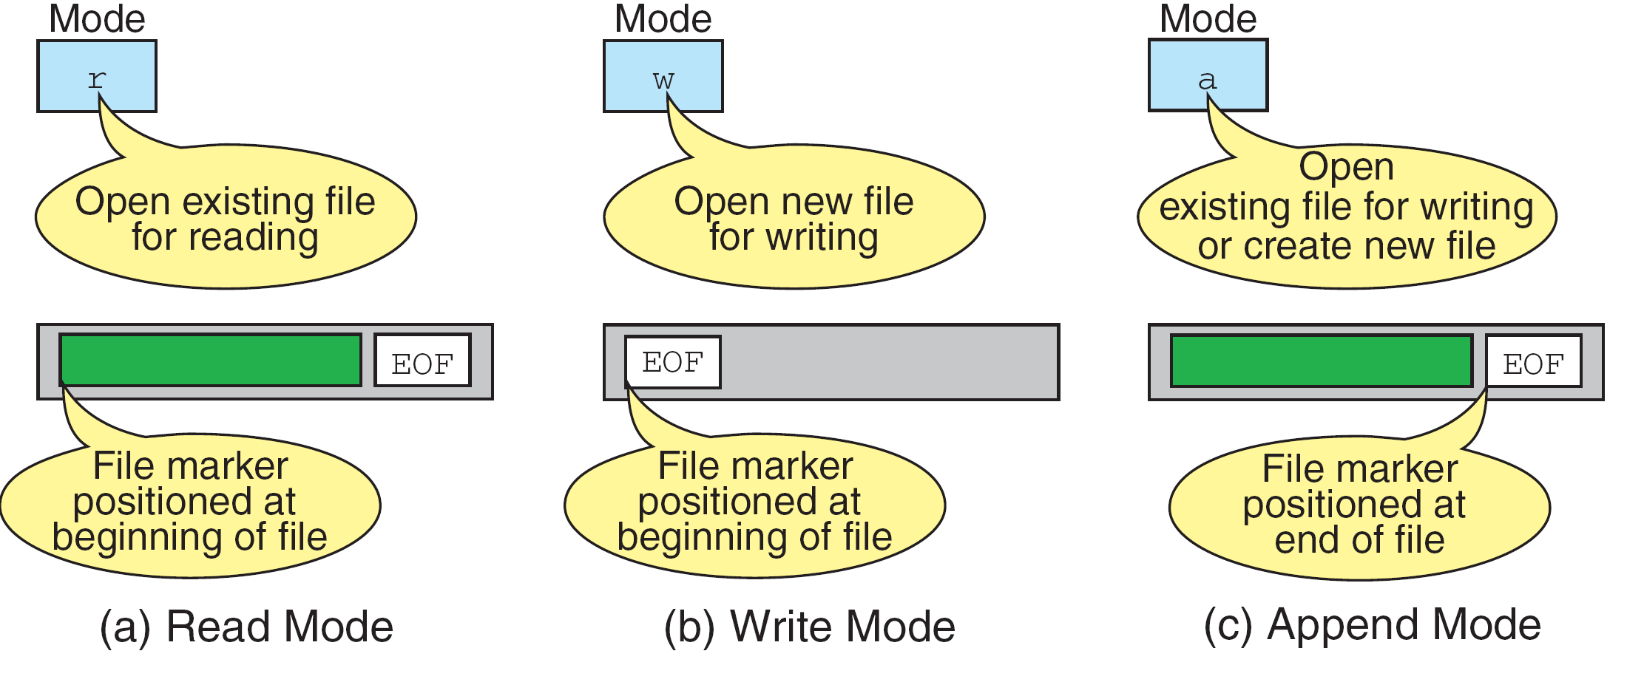
More on File Open Modes
from Figure 7-4 in Forouzan & Gilberg, p. 401

Slide 7
Additionally,
r+ - open for reading and writing, start at beginning
w+ - open for reading and writing (overwrite file)
a+ - open for reading and writing (append if file exists)

Slide 8
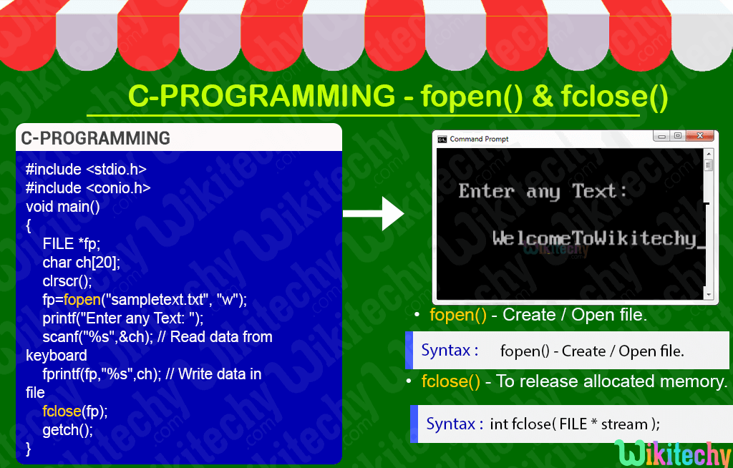

Slide 9
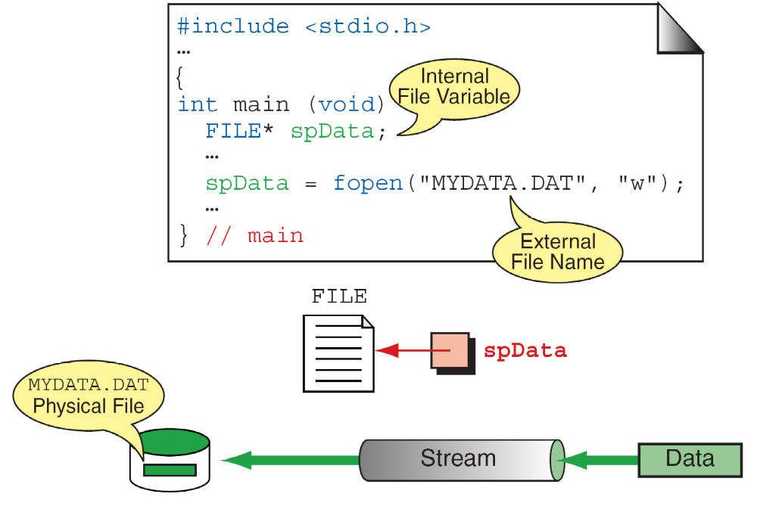
More On fopen
from Figure 7-3 in Forouzan & Gilberg, p. 399

Slide 10
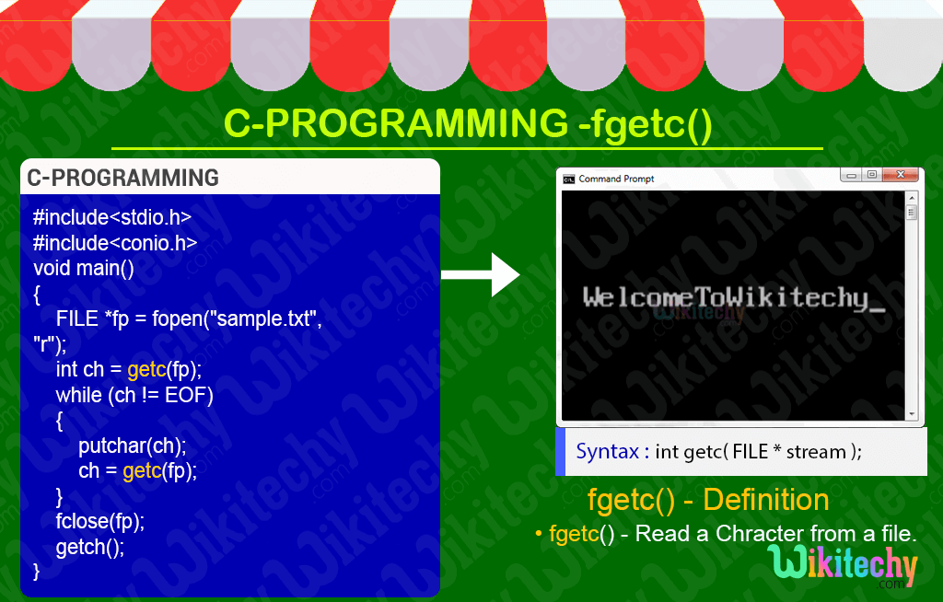

Slide 11
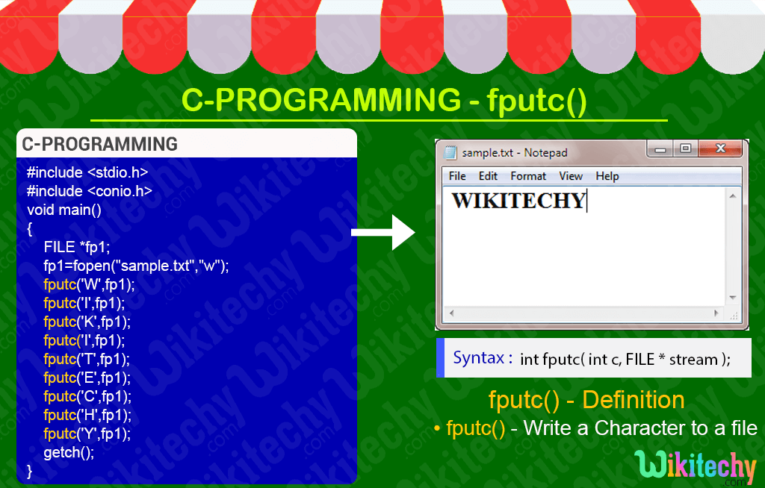

Slide 12
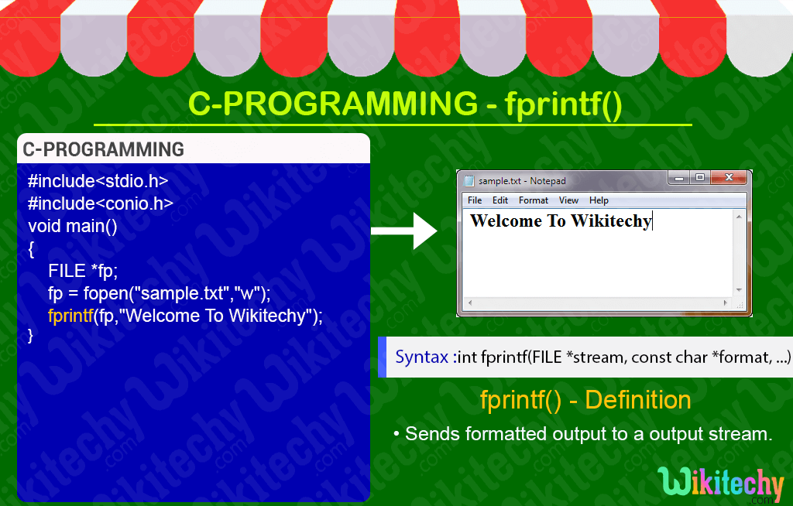

Slide 13
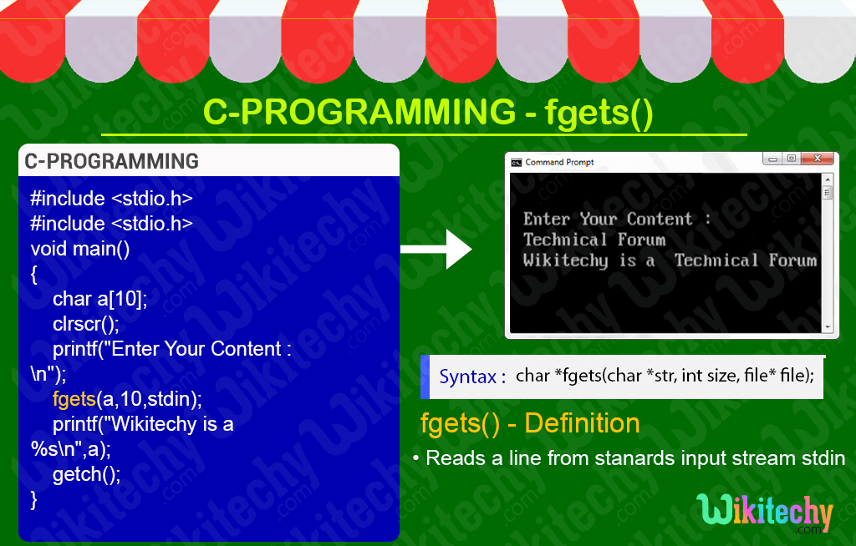

Slide 14
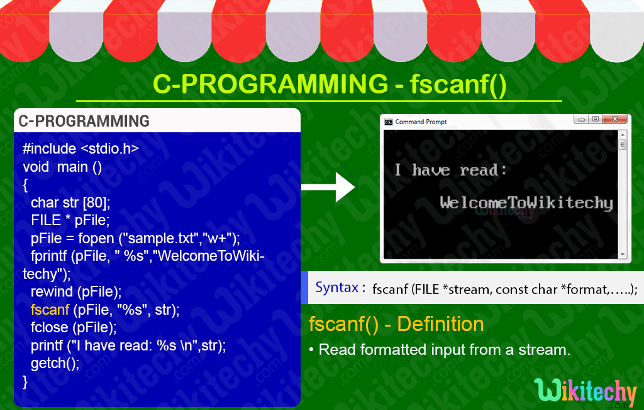

Slide 15
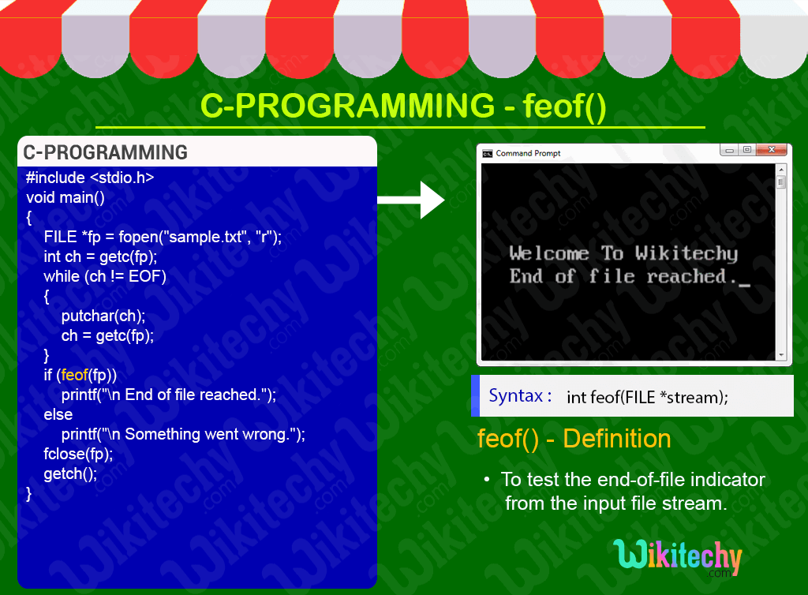

Slide 16
fread () binary files
Declaration:
size_t fread(void *ptr, size_t size, size_t n, FILE *stream);
Remarks:
fread reads a specified number of equal-sized
data items from an input stream into a block.
ptr = Points to a block into which data is read
size = Length of each item read, in bytes
n = Number of items read
stream = file pointer

Slide 17
Example
  Example:
  #include <stdio.h>
  int main()
  {
  FILE *f;
  char buffer[11];
  if (f = fopen("fred.txt", “r”))
  {
  fread(buffer, 1, 10, f);
  buffer[10] = 0;
  fclose(f);
  printf("first 10 characters of the file:\n%s\n", buffer);
  }
  return 0;
  }

Slide 18
fwrite() binary files
Declaration:
size_t fwrite(const void *ptr, size_t size, size_t n, FILE*stream);
Remarks:
fwrite appends a specified number of equal-sized data items to an output file.
ptr = Pointer to any object; the data written begins at ptr
size = Length of each item of data
n =Number of data items to be appended
stream = file pointer

Slide 19
Example
Example:
  #include <stdio.h>
  int main()
  {
    char a[10]={'1','2','3','4','5','6','7','8','9','a'};
    FILE *fs;
    fs=fopen("Project.txt","w");
    fwrite(a,1,10,fs);
    fclose(fs);
    return 0;
  }

Slide 20
fseek()
This function sets the file position indicator for the stream pointed to by stream or you can say it seeks a specified place within a file and modify it.
  SEEK_SET Seeks from beginning of file
  SEEK_CUR Seeks from current position
  SEEK_END Seeks from end of file
Example:
#include <stdio.h>
int main()
{
FILE * f;
f = fopen("myfile.txt", "w");
fputs("Hello World", f);
fseek(f, 6, SEEK_SET); SEEK_CUR, SEEK_END
fputs(" India", f);
fclose(f);
return 0;
}

Slide 21
ftell()
offset = ftell( file pointer );
"ftell" returns the current position for input or output on the file
#include <stdio.h>
int main(void)
{
FILE *stream;
stream = fopen("MYFILE.TXT", "w");
fprintf(stream, "This is a test");
printf("The file pointer is at byte %ld\n", ftell(stream));
fclose(stream);
return 0;
}

Slide 22
THANK YOU

